Slide 1

Database

Slide 2
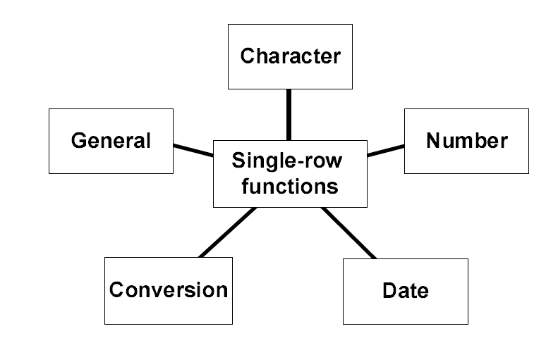
Single row functions

Slide 3

Date
Default format: DD-MON-YY
SYSDATE is a function returns the current date.

Slide 4
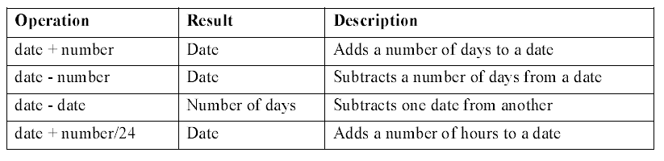
Arithmetic with Dates

Slide 5
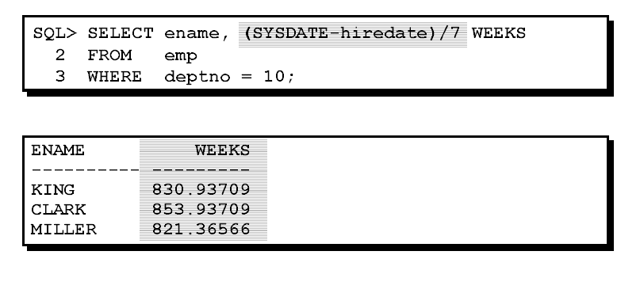
Arithmetic with Dates

Slide 6
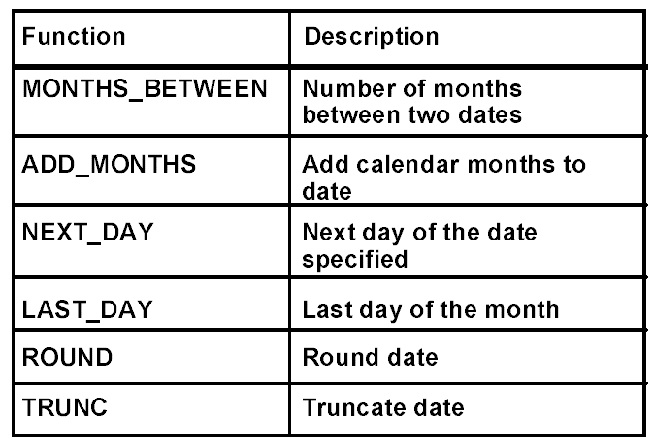
Date functions

Slide 7
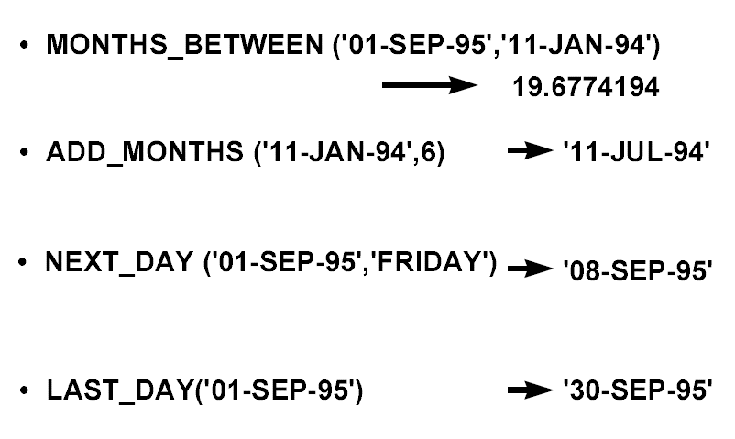
Example

Slide 8
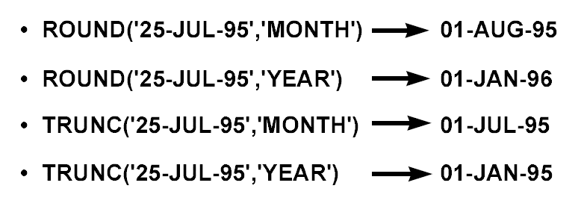
Date manipulation

Slide 9
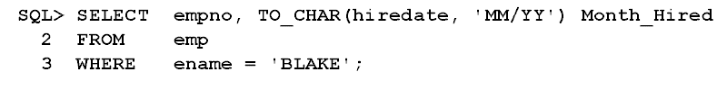
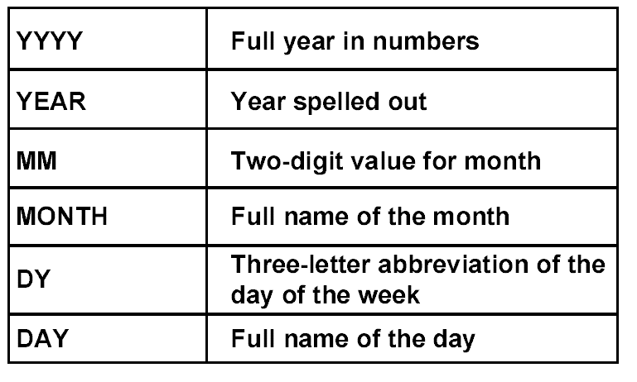
To_char function with dates

Slide 10
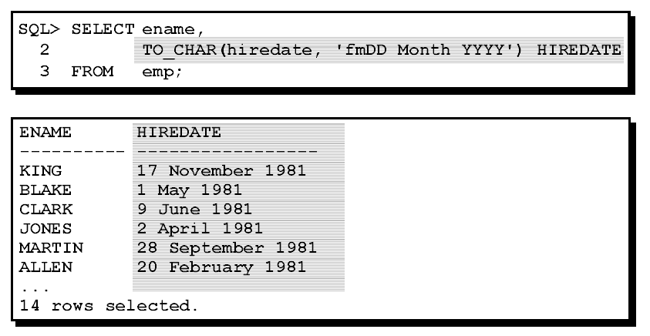
Example

Slide 11
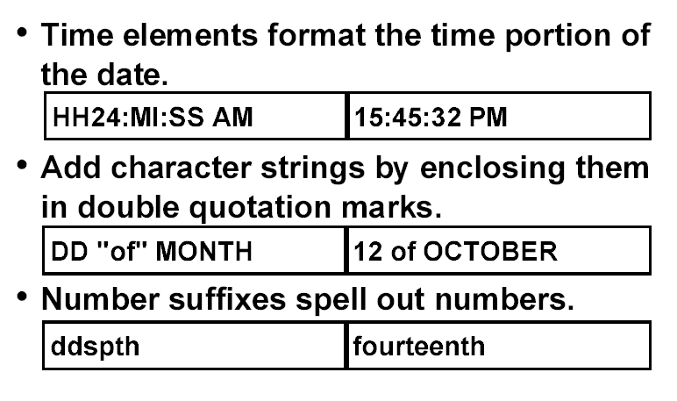
Elements of Date format

Slide 12
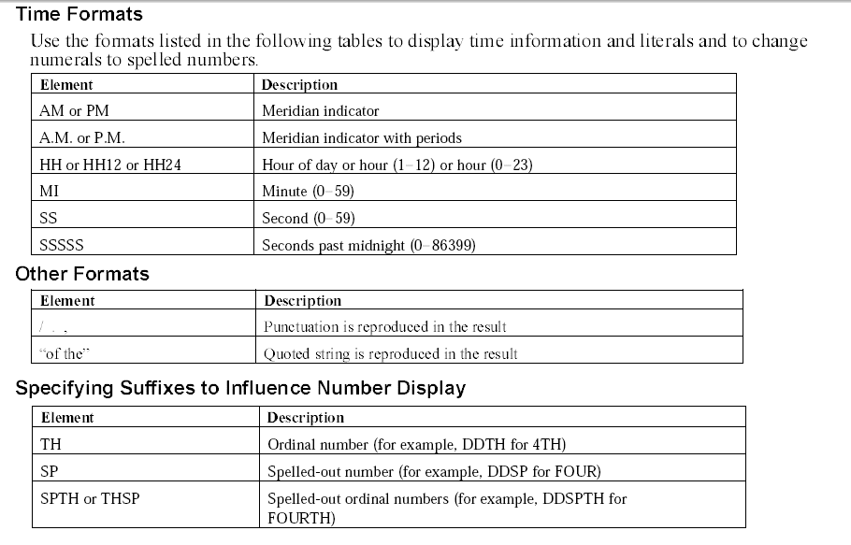

Slide 13
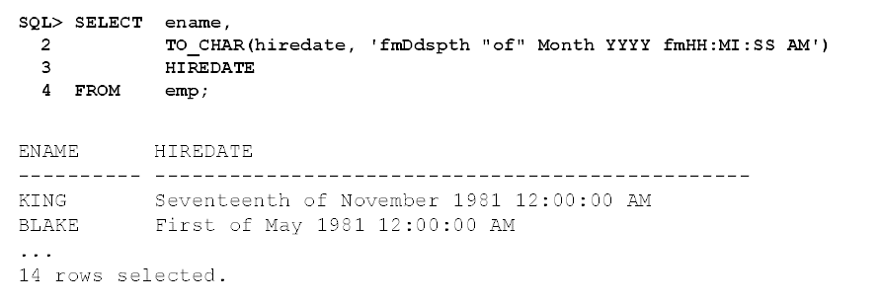
Examples
Select * from emp where to_char(hiredate,’MON’)=‘FEB’
<, > , like with dates

Slide 14
Example
Select * from emp where
to_char(hiredate,’dd-mon-yyyy’)<’09-jan-1999’
Let the hiredate be ’09-apr-2015’, this comparison will result with wrong answer.
’09-apr-2015’ < ’09-jan-1999’

Slide 15
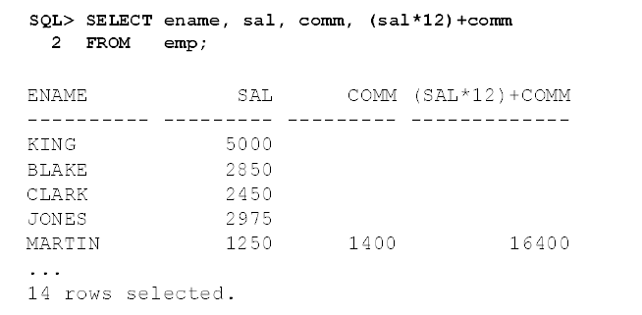
Null values- operations

Slide 16
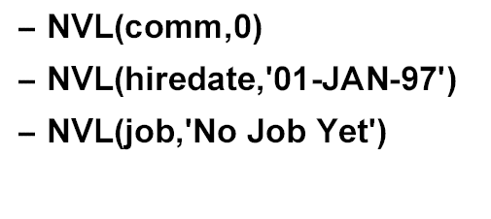
Null values – nvl function
Convert null to actual values

Slide 17
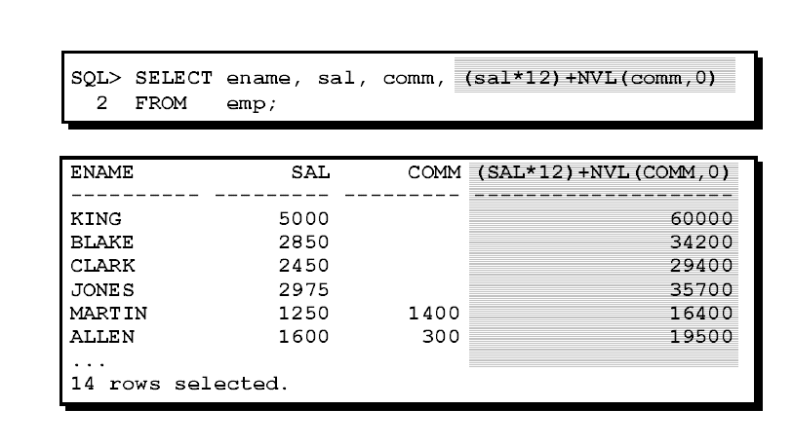
Example

Slide 18
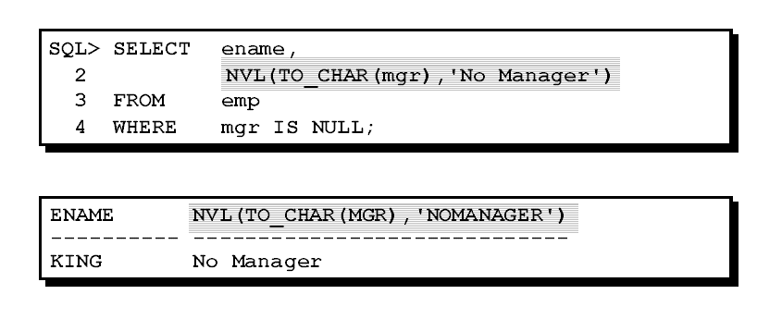
Nesting functions

Slide 19
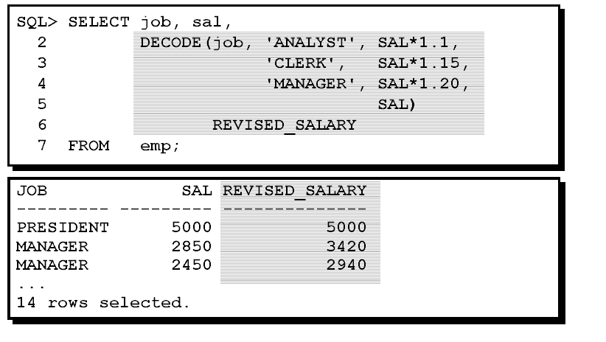
Decode Function

